Slide 1

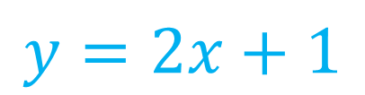


Algebra Interactive Notebook
$$3ab$$
$$\frac{5xy}{6}$$
Name :
Class :
Term 1 Semester 1
$$2x+3y$$
$$y=2x+1$$

Slide 2
Contents
Glossary
Page
Date
Description
2
3

Slide 3
Tasks
24
7
30
Essential Question
Questions
Notes
Summary
4
7

Slide 4
Simplifying Expressions
24
7
30
EQ: How do I simplify algebraic expressions with multiplication?

Slide 5
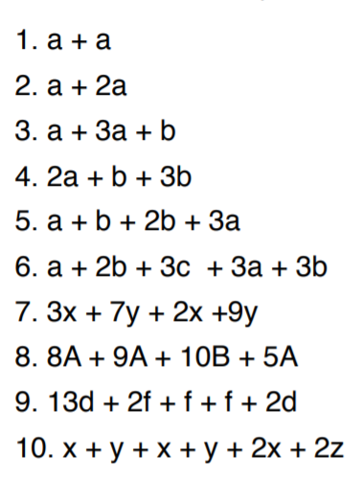
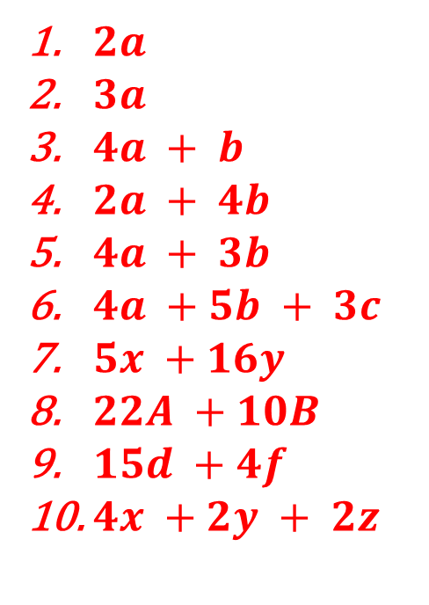
Revision - lhs
$2a$
$3a$
$4a + b$
$2a + 4b$
$4a + 3b$
$4a +5b + 3c$
$5x +16y$
$22A +10B$
$15d +4f$
$4x +2y + 2z$

Slide 6
Think
If each person is holding 2 baskets of bananas and there are 3 people.
Write this as an algebraic expression for the total number of bananas.
How many different ways can you write this algebraic expression?
Let B represent the number of bananas in a basket
Amount of bananas = 2B + 2B + 2B
3 x 2B, 6B
If we have 3 lots of people holding 2 crates of bananas (2B)
we have (3x2)B which gives us 6 baskets of bananas (6B) so, 3 x 2B = 6B

Slide 7

Simplifying Expressions
24
7
30
EQ: How do I simplify algebraic expressions with multiplication?
How do I multiply terms?
Simplify the following expressions
Example:
$4 ×3a =$
$3d ×4e=$
$6a ×3a=$
$5mn ×−2m$²$n$ =
Don’t forget
NUMBERS first
ALPHABET (in order) second

Slide 8
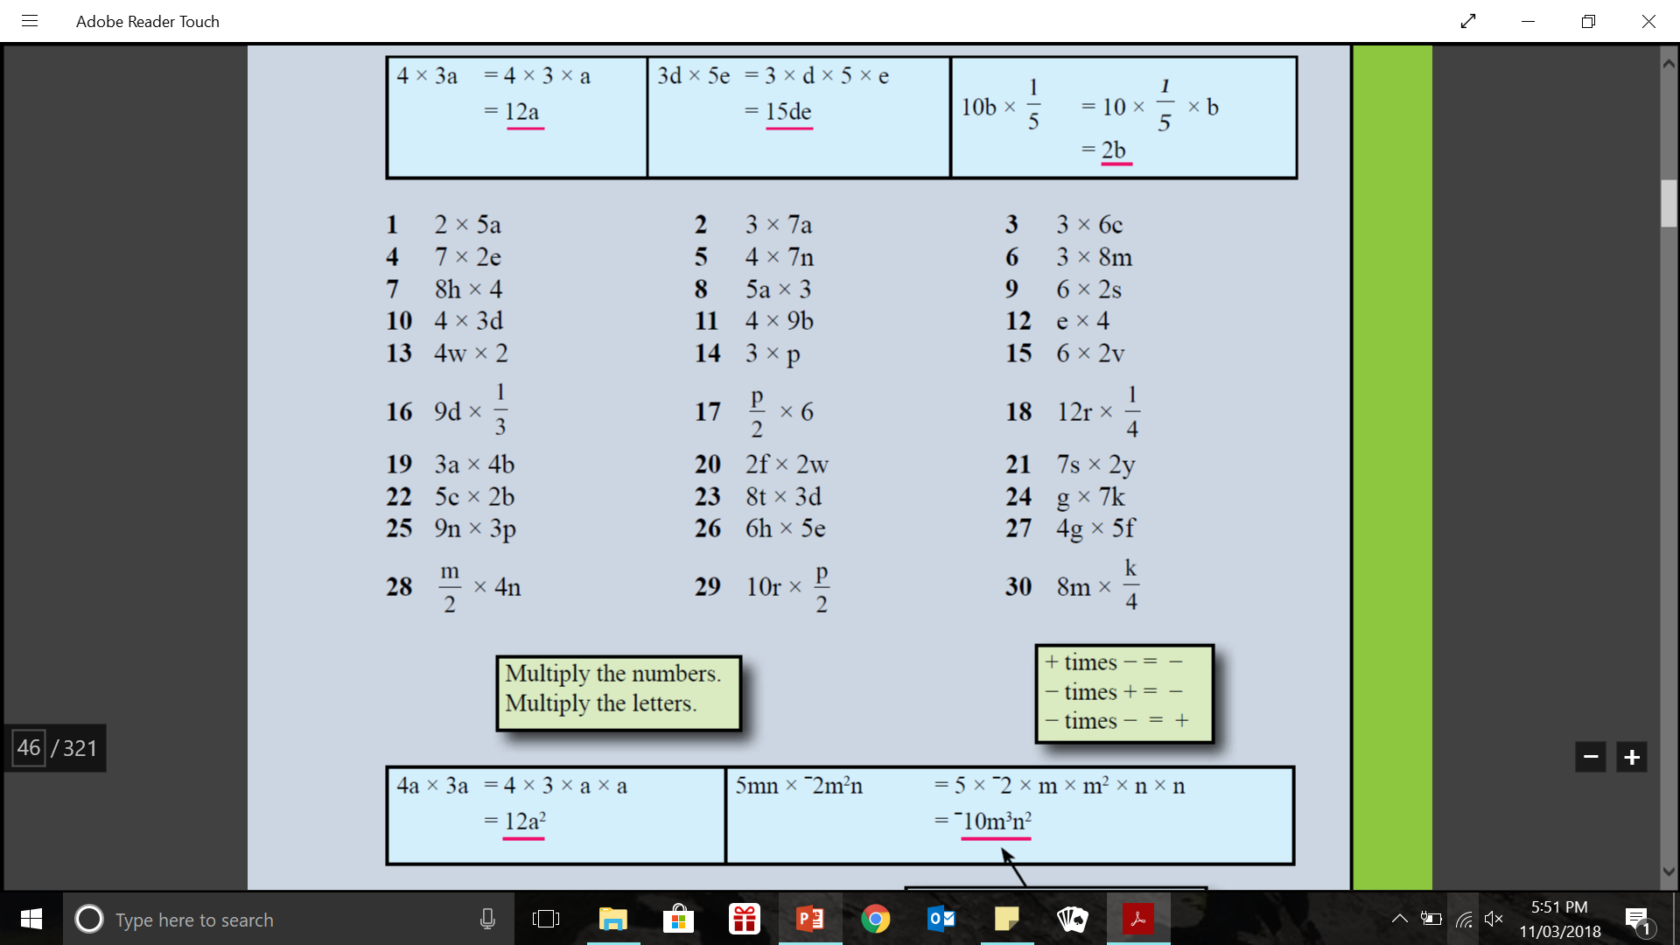
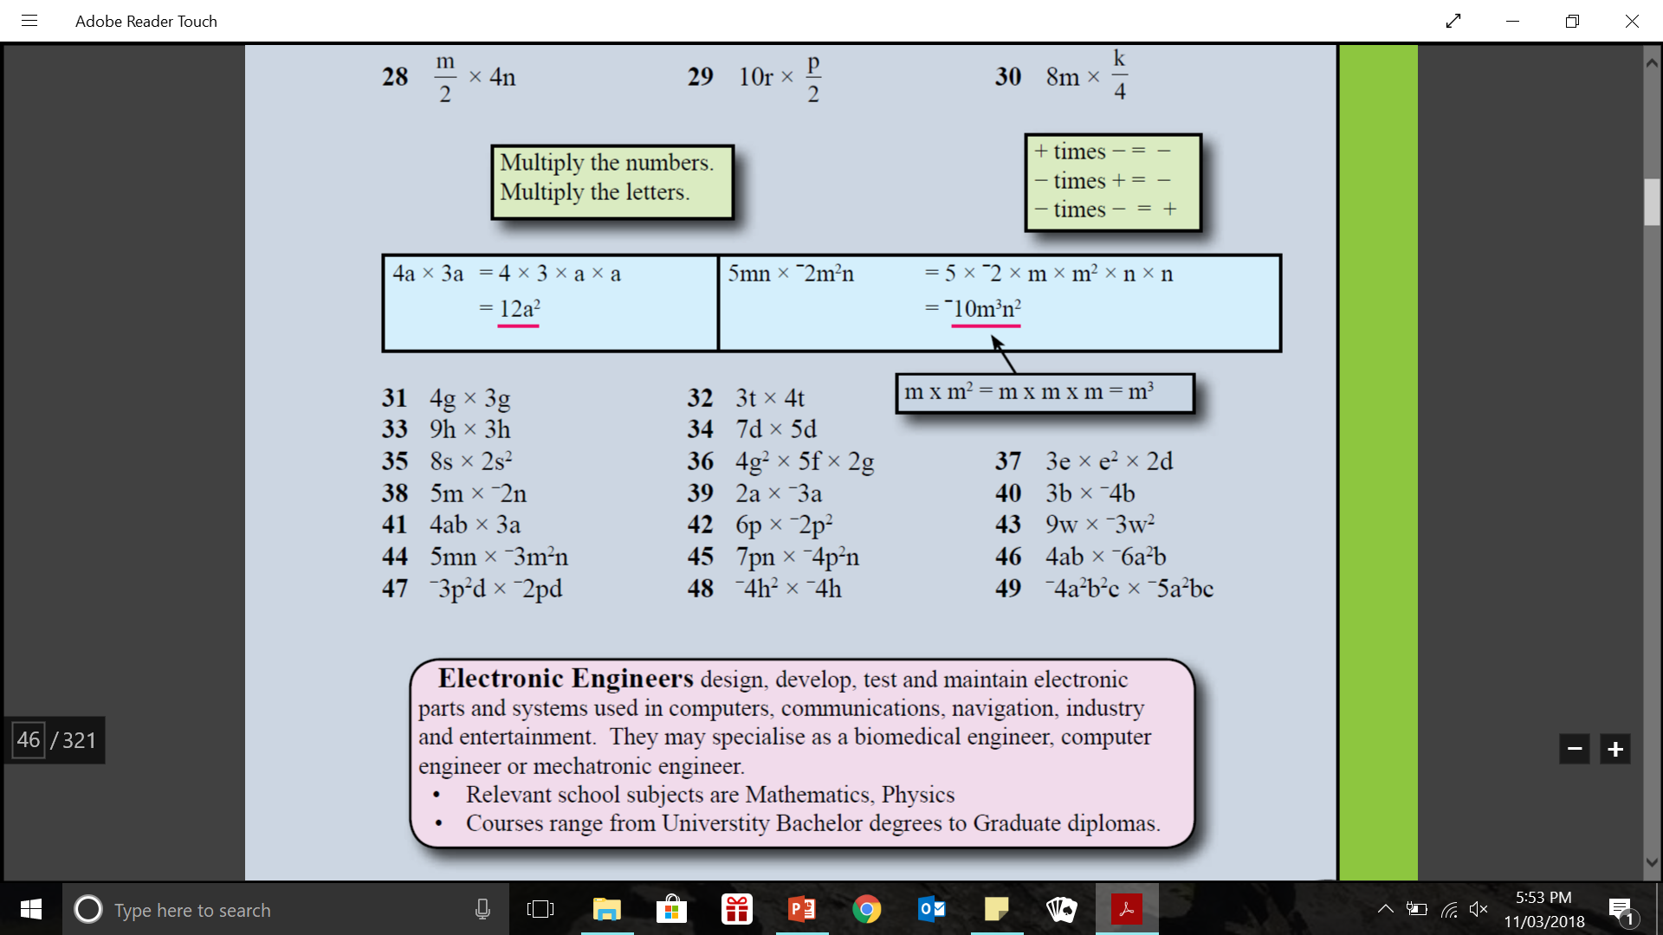
practice: - lhs

Slide 9
Class practice
Dwyer page 37

Slide 10

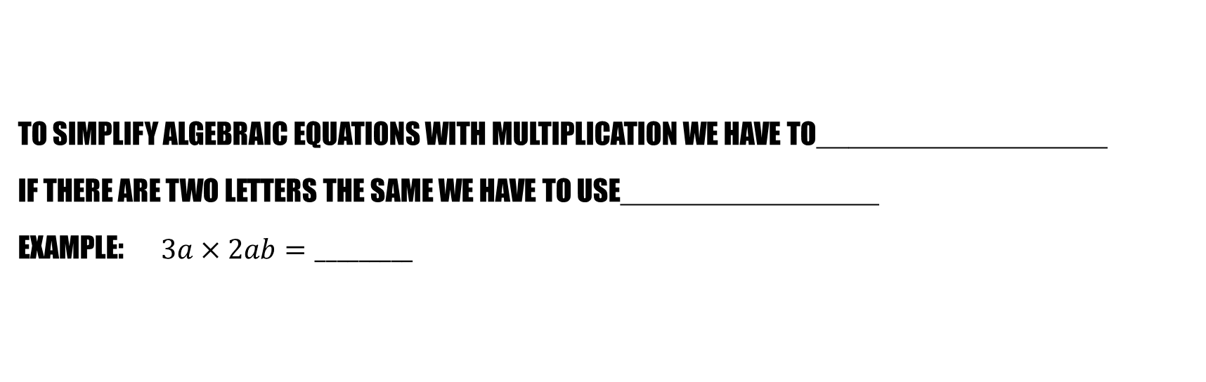
Summary (sentence frames)
To simplify algebraic equations with multiplication we have to__________________
If there are two letters the same we have to use________________
Example: $3a×2ab=_________$

Slide 11
Lesson 2 Dividing
Eq: How do I simplify algebraic expressions with division?

Slide 12
Revision Quickwrite 1 mInute
What did we learn in class last lesson?
Hints: algebra, multiplying
BE prepared to share you answers

Slide 13


Simplifying Expressions
24
7
30
EQ: How do I simplify algebraic expressions with Division?
How do I divide terms?
Simplify the following expressions
Example:
$8b ÷2= \frac{8b}{2} = 4b$
$6d÷4d= \frac{6d}{4d} =$ $\frac{3}{2}$
$18ay÷4a= \frac{18ay}{4a} =$ $\frac{9y}{2}$
Like with multiplying
We divide the numbers
If there is a letter on the
Top and bottom we can cancel
Them out
Fun Fact:
The division sign is another way of writing fractions
The dots on the top and bottom is where the numbers go
$3÷4=\frac{3}{4}$

Slide 14
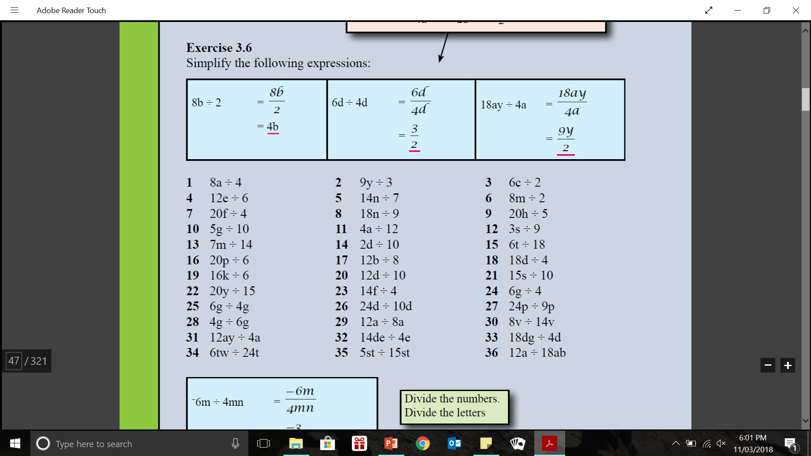
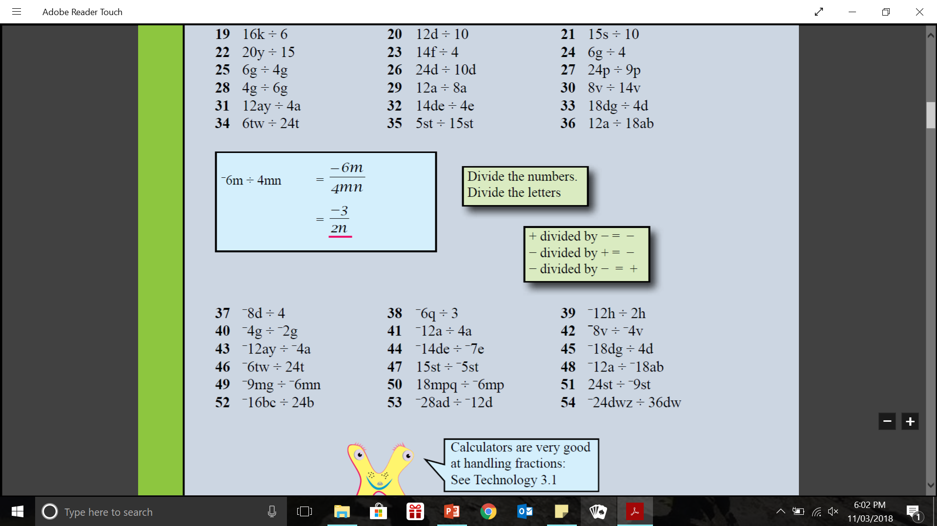
practice: - lhs

Slide 15
Class practice
Page 38 dwyer text books.

Slide 16
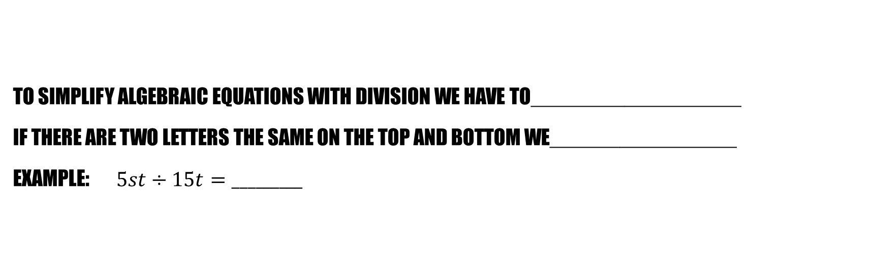
Summary (sentence frames)
To simplify algebraic equations with division we have to__________________
If there are two letters the same on the top and bottom we________________
Example: $5st÷15t=_________$

